Slide 1

Document auto-tagging for pedagogy

Slide 2


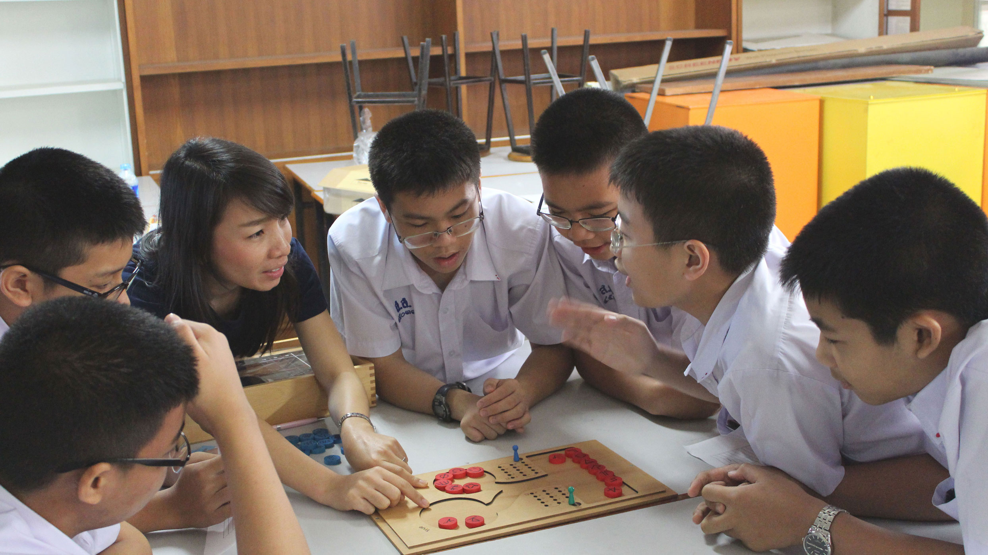
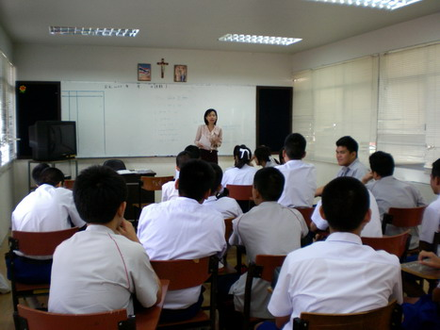

Notes:
- Nowaday, a Thailand educational system is not totally equal. There are a lot of the disparity between schools in cities and countryside due to a lack of knowledge about how to teach students effectively (pedagogy). To make this situation gets better, A knowledge need to be spread widely to gain the pedagogy knowledge on all schools in Thailand. So, we decide to troubleshoot this problem by creating a community that teachers and people who interested can get documents on how to improve a teaching performance and study from those documents to adapt their teaching style and increasing a school quality in Thailand.

Slide 3
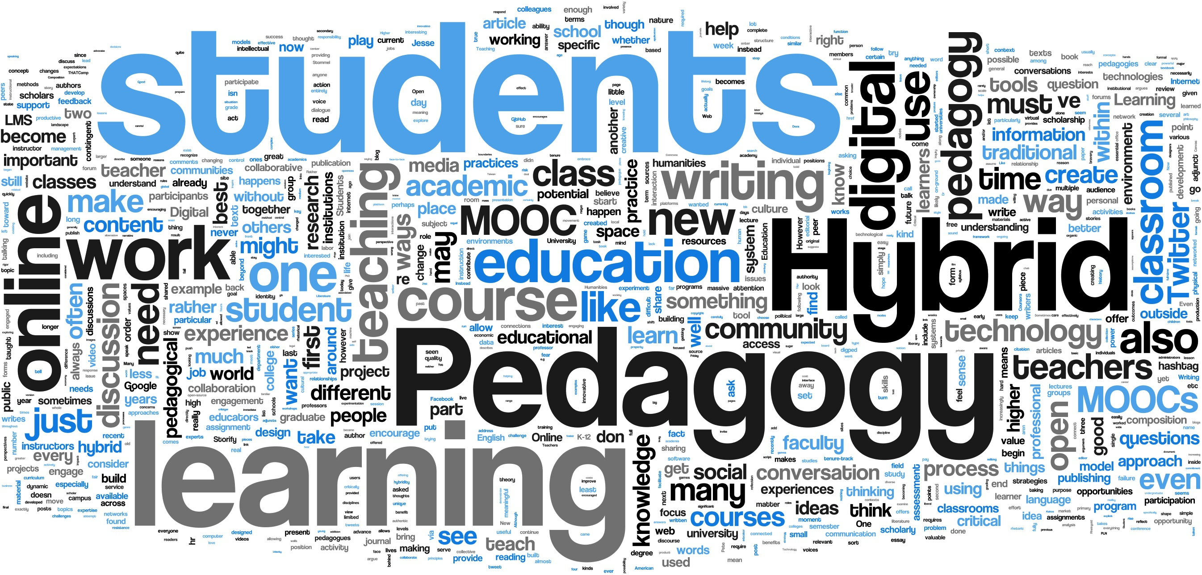

Motivation
Notes:
- Nowaday, a Thailand educational system is not totally equal. There are a lot of the disparity between schools in cities and countryside due to a lack of knowledge about how to teach students effectively (pedagogy). To make this situation gets better, A knowledge need to be spread widely to gain the pedagogy knowledge on all schools in Thailand. So, we decide to troubleshoot this problem by creating a community that teachers and people who interested can get documents on how to improve a teaching performance and study from those documents to adapt their teaching style and increasing a school quality in Thailand.

Slide 4




Notes:
To make this thing happen, We created a websites that contain loads of documents about pedagogy from Thai schools. Since there’re a lots of category on pedagogy, Documents will be separated by tags that will mark categories on each paragraph of documents. Users will be able to search interesting tags and get those related paragraphs and documents and interact with other users by giving a rating and comment to each document.
The documents on the website will be categorized automatically by using a machine learning techniques so we don’t need so much people to read and categorize those documents by themselves. And this machine learning will concern about rating of each document, so a machine learning will be more effective when the time passed by.

Slide 5
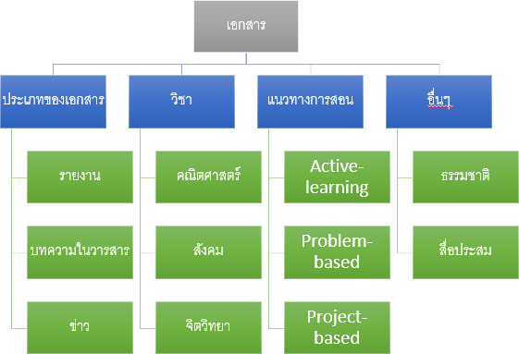

Notes:
In the first step, we get documents in Thai language from selected schools which provide some good pedagogy contents on many categories. A Sodsri-Saridwong foundation provides documents and selected experts for tagging each paragraph on documents to use on machine learning.

Slide 6



Notes:
After we get tagged documents, paragraphs will be splits and send to a program that detect Thai words and learns how to categorize paragraphs. Then a categorized data and machine learning model will be stored into database.

Slide 7
Notes:
After we collected enough tagged documents for machine learning system, more new documents in Thai language will be loaded into program and then paragraphs in those documents will be categorized automatically, and stored into database for searching. Those new documents come from famous schools in Thailand that want to share their pedagogy knowledge to other schools that don’t get much opportunity for improving their teaching performance.

Slide 8
Notes:
After we collected enough tagged documents for machine learning system, more new documents in Thai language will be loaded into program and then paragraphs in those documents will be categorized automatically, and stored into database for searching. Those new documents come from famous schools in Thailand that want to share their pedagogy knowledge to other schools that don’t get much opportunity for improving their teaching performance.

Slide 9




Component
Notes:
In our platform, we have 3 main components. First we use an Azure Machine Learning to make a model for prediction. Second we have an Azure database for storing data from machine learning model. Last we use an Azure web service to host a community website for teachers and users.

Slide 10

Existing platform
Notes:
In market, there’s a software called Stanford Deepdive. It uses machine learning to find a keyword from document, similar to our program, but Stanford Deepdive supports only for English language while our platform supports Thai language.

Slide 11

Marketing group
Notes:
We target on the teachers in Thailand to improve their pedagogy knowledge by studying documents from our website. So our main target are foundations that concern about improving educational quality in Thailand such as Sodsri-Saridwong foundation or Thai Education foundation. And the further target is a government organization that take charge of managing about education in Thailand, the Ministry of Education.

Slide 12
Team member
Mr. Perth CPE KMUTT
Mr. Nut CPE KMUTT
Mr. Art CPE KMUTT

